Slide 1

Müasir tibbi tədqiqatlarda və klinik tibbdə etibarlı informasiya resursları
Allahverdi Shahveranov,
6th course, AMU

Slide 2

Some quotes about Internet
"You do not know our culture, our ethics, or the unwritten codes that already provide our society more order than could be obtained by any of your impositions."
Source: A Declaration of the Independence of Cyberspace. John Perry Barlow. Davos, Switzerland. February 8, 1996.

Slide 3





Slide 4
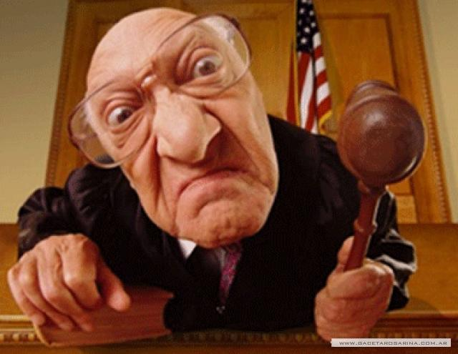
Hansi saytdan dozani teyin etmisiniz?

Slide 5
Etibarli Klinik Tibbi Internet Saytlari nədir?
Premier evidence-based clinical decision support resource authored by physicians to help healthcare practitioners make the best decisions at the point of care.
By combining the latest clinical knowledge with cutting-edge technology, UpToDate changes the way clinicians practice medicine and has become an indispensable part of clinical workflows in institutions and practices worldwide.

Slide 6
Etibarli Klinik Tibbi Internet Saytlari
1. http://www.nih.gov/ - National Institute of Health
2. http://www.cdc.gov/ - Centers for Disease Control and Prevention
3. http://www.uptodate.com/ - premier evidence-based clinical decision support resource
4. http://www.who.int/ - World Health of Organization.

Slide 7

Bes Dermanlar ?
http://www.fda.gov/ - Food and Drug Administration ( FDA )

Slide 8
Bes Tibbi Tedqiqatlar ?
Generally Tedqiqatlar ?
http://www.ncbi.nlm.nih.gov/pubmed
http://www.nature.com/
http://www.pnas.org/
http://www.thelancet.com/
http://www.nih.gov/

Slide 9
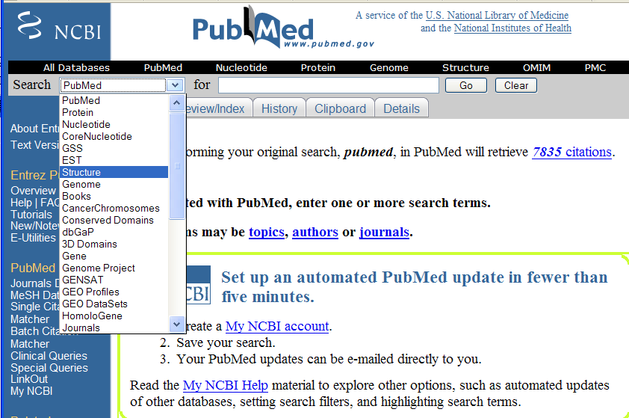

Slide 10
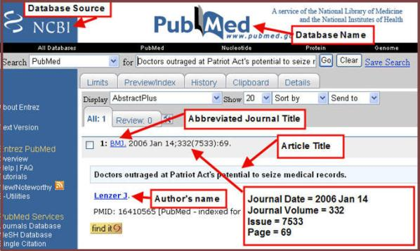

Slide 11
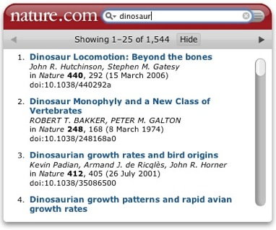

Slide 12
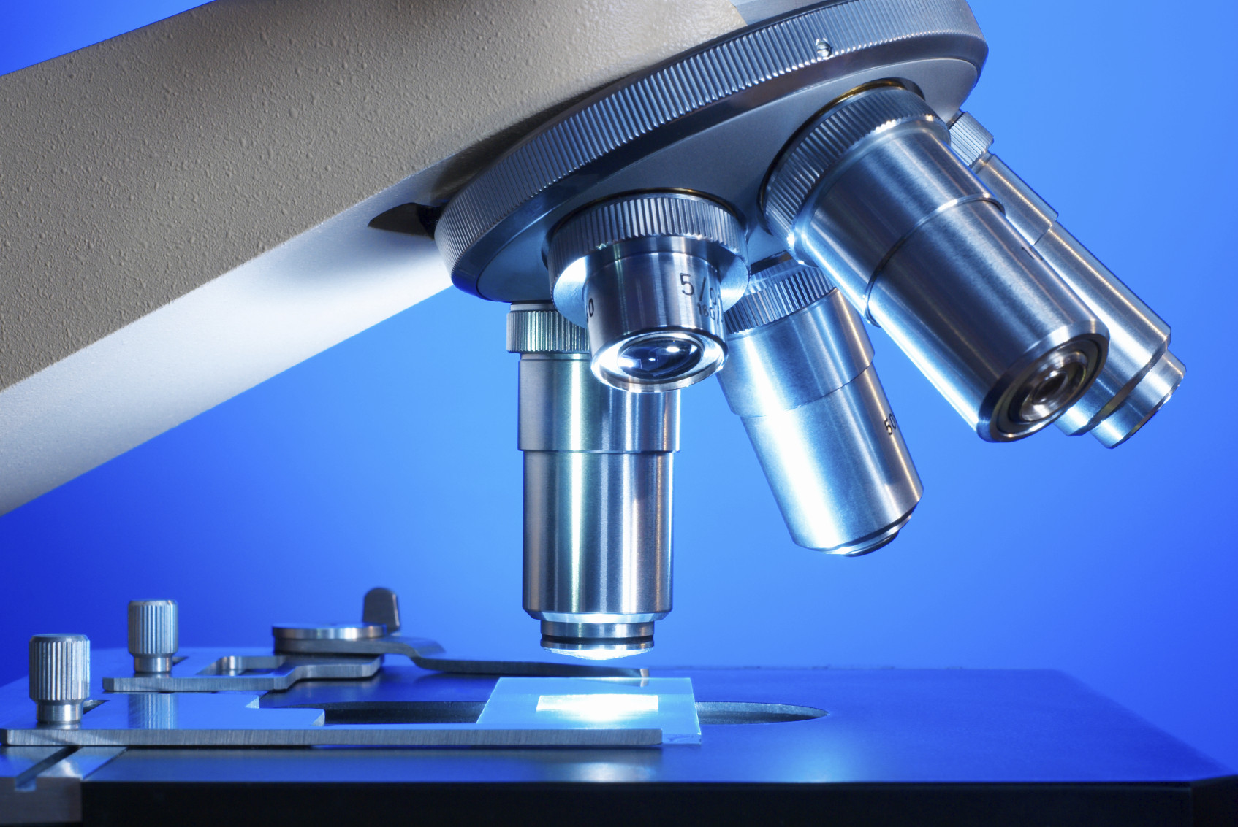
Thanks for attention ☺

